Slide 1
Title: Economic Sector of India
Subtitle: Insights from Consumer Price Index, Gross Domestic Product, Wholesale Price Index, and Key National Indicators
Aditya Kumar RA2211003010691 K1 Information Visualization

Slide 2
Introduction
Objective: Present key insights from five Power BI dashboards focusing on CPI, GDP, WPI, and additional analyses. Highlight trends, comparisons, and economic indicators across various datasets.
Dashboards Covered:
1. Consumer Price Index (CPI)
2. State-wise Gross Domestic Product (GDP)
3. Wholesale Price Index (WPI)
4. State-wise CPI Analysis
5. Key National Economic Indicators

Slide 3


Slide 4
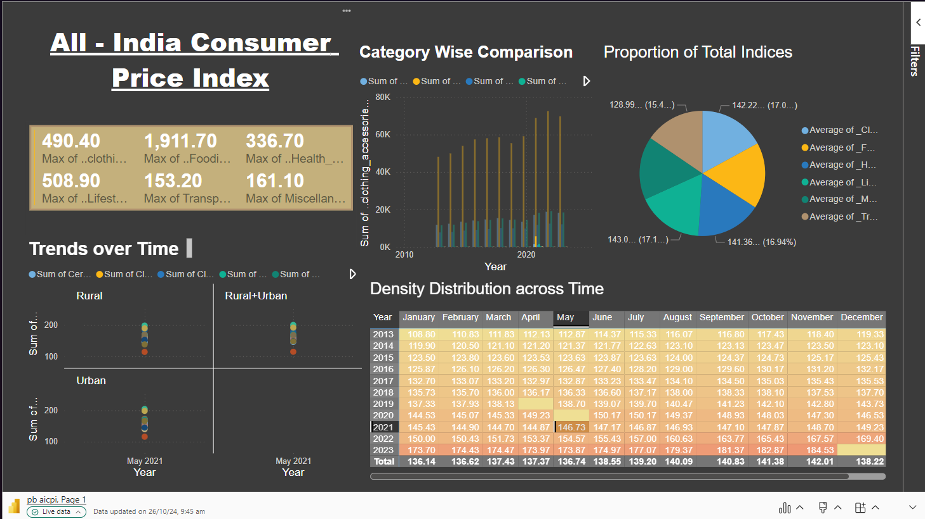

Slide 5
Consumer Price Index (CPI) Dashboard
Title: Consumer Price Index (CPI) Dashboard
Key Metrics:
Max Values: Peak indices for categories such as Clothing, Food, Health, etc.
Visuals:
Trend Charts: Show CPI trends over time for Rural, Urban, and combined sectors.
Comparison Bars: Category-wise comparison to highlight top contributors.
Insights:
Significant variations in different categories, with clothing and food dominating.
Steady upward trend across sectors, reflecting inflation and consumer behavior.

Slide 6
Category & Proportion Analysis (CPI)
Title: Category & Proportion Analysis (CPI)
Visuals:
Bar Chart: Annual comparison across categories.
Pie Chart: Proportion of total indices per category.
Insights:
Clothing and food represent the largest portions, indicating their weight in the CPI basket.

Slide 8
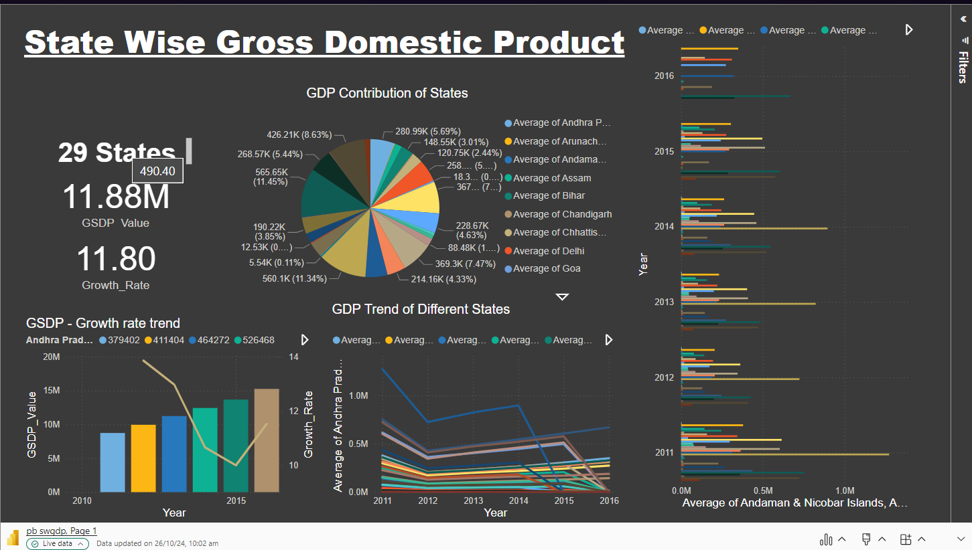

Slide 9
State-wise Gross Domestic Product (GDP) Dashboard
Key Metrics:
GDP Value & Growth Rate: Analysis across 29 states, with a focus on top contributors.
Visuals:
Pie Chart: Breakdown of GDP contribution by state.
Bar & Line Charts: Trends showcasing growth over the years.
Insights:
Major contributors like Maharashtra and Andhra Pradesh show steady economic growth.
Variations across states reflect development disparities and regional economic strengths.

Slide 10
GDP Growth Trends Comparison
Visuals:
Line Chart: Comparison of GDP growth trends across top states.
Highlight: Performance of states like Delhi, Maharashtra, etc.
Insights:
Economic robustness in leading states, with consistent growth patterns over time.

Slide 11
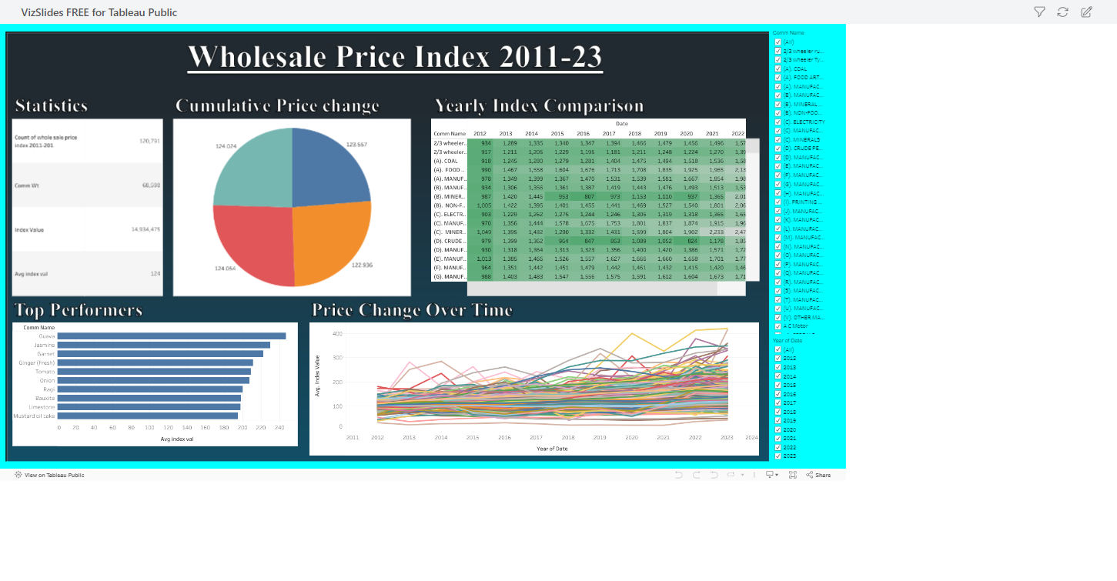

Slide 12
Wholesale Price Index (WPI) Dashboard
Key Metrics:
Cumulative Price Change: Analysis by year from 2011-2023.
Visuals:
Pie Chart: Price change distribution across key commodities.
Bar & Line Charts: Trends over time, highlighting significant price changes.
Insights:
Commodities like Guava and Jasmine reflect the most significant growth.
Steady increases in prices hint at broader inflation trends over the years.

Slide 13
Annual Comparisons (WPI)
Visuals:
Table: Year-wise comparison across various commodities.
Line Chart: Trends showcasing significant changes across peak years.
Insights:
Helps track sector-specific price changes, aiding in understanding market dynamics.

Slide 14
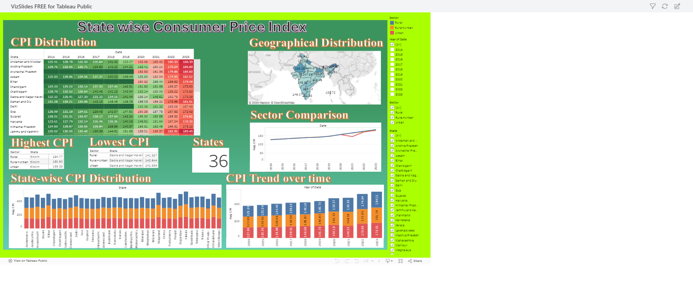

Slide 15
State-wise CPI Analysis
Key Metrics:
State-wise CPI Trends: Detailed view of CPI by state, sector, and over time.
Visuals:
Heatmap: Year-over-year CPI changes by state, highlighting states with the highest and lowest CPI.
Geographical Map: Visual distribution of CPI across regions.
Sector Comparison: Average CPI comparison across different sectors (Rural, Urban).
Trend Charts: CPI trend over time for various sectors and states.
Insights:
Regional variations in CPI, with Sikkim showing high values.
Sector comparison highlights differences in CPI trends across rural, urban, and combined sectors.

Slide 16
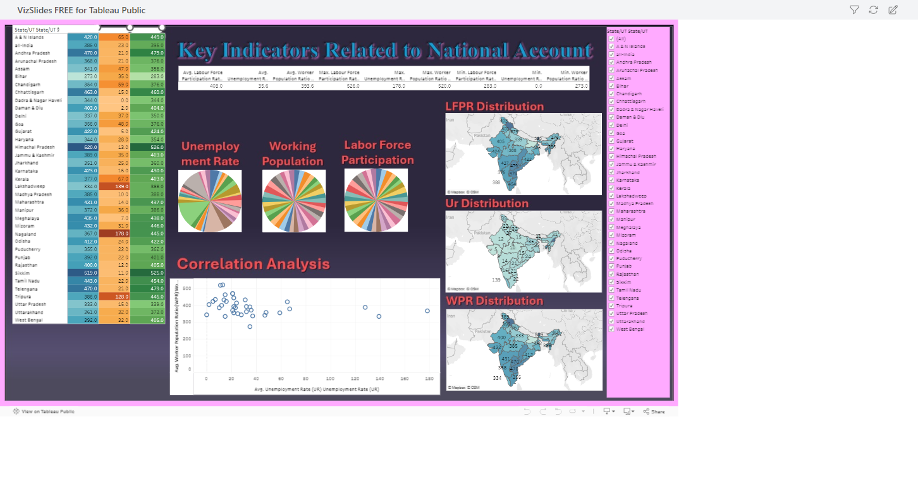

Slide 17
Key National Economic Indicators (Additional Dashboard 2)
Key Metrics:
Labour Force Participation Rate (LFPR), Unemployment Rate (UR), Working Population Ratio (WPR).
Visuals:
Pie Charts: Distribution of Unemployment Rate, Working Population, and Labor Force Participation.
Geographical Maps: LFPR, UR, and WPR distribution by state, indicating regional labor dynamics.
Correlation Analysis: Scatter plot showing the relationship between unemployment rate and worker participation rate.
Insights:
Maps and charts show variations in employment and labor participation across states.
Correlation analysis provides insights into employment trends, useful for policy-making.

Slide 18
Summary of Key Insights
Insights:CPI: Reflects sectoral growth trends, with variances between rural and urban sectors.
GDP: Highlights economic disparities and top-performing states.
WPI: Tracks inflation trends across major commodities.
Additional Dashboards: Provide deeper insights into region-specific and labor-related economic patterns.

Slide 19
Conclusion & Recommendations
Summary:
Key insights from the five dashboards and their implications.
How these findings can guide policy-making, economic planning, or business decisions.
Recommendations:
Suggested actions based on data trends, like investment focus areas or policy changes.

